Slide 1
go routines
concurrency and parallelism

Slide 2
concurrency and parallelism
“Concurrency is the composition of independently executing processes, while parallelism is the simultaneous execution of (possibly related) computations. Concurrency is about dealing with lots of things at once. Parallelism is about doing lots of things at once.”

Slide 3
concurrency
doing many things, but only one at a time
“multitasking”
parallelism
doing many things at the same time
A
A
B
B
C
C

Slide 4
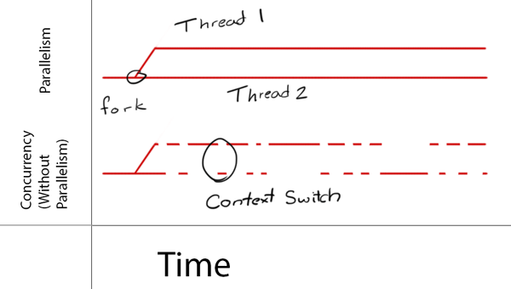
http://cdn1.raywenderlich.com/wp-content/uploads/2014/01/Concurrency_vs_Parallelism.png

Slide 5
notes

Slide 6
go

Slide 7
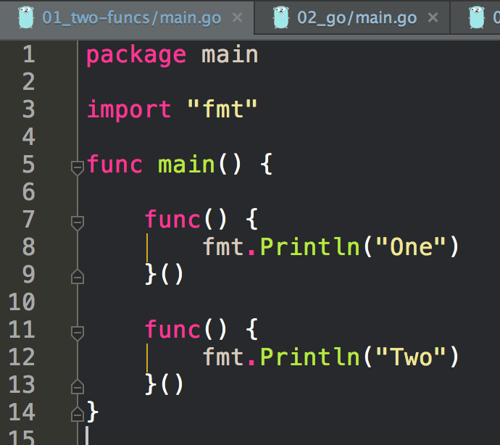
these files are all from
pluralsight’s concurrency training
http://www.pluralsight.com/courses/go-concurrent-programming

Slide 8
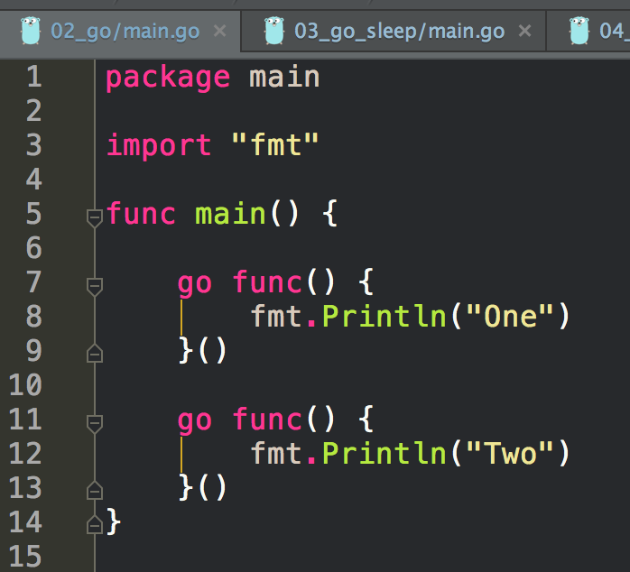

Slide 9
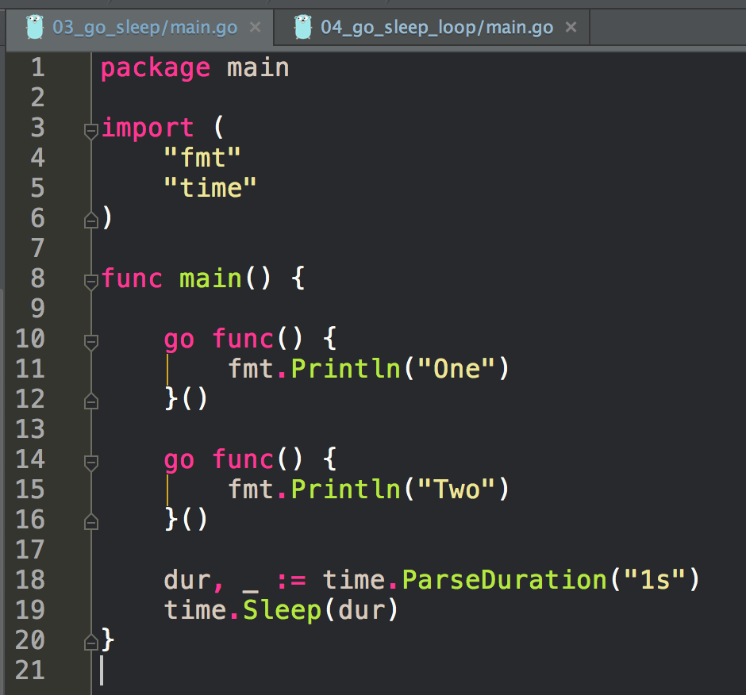

Slide 10
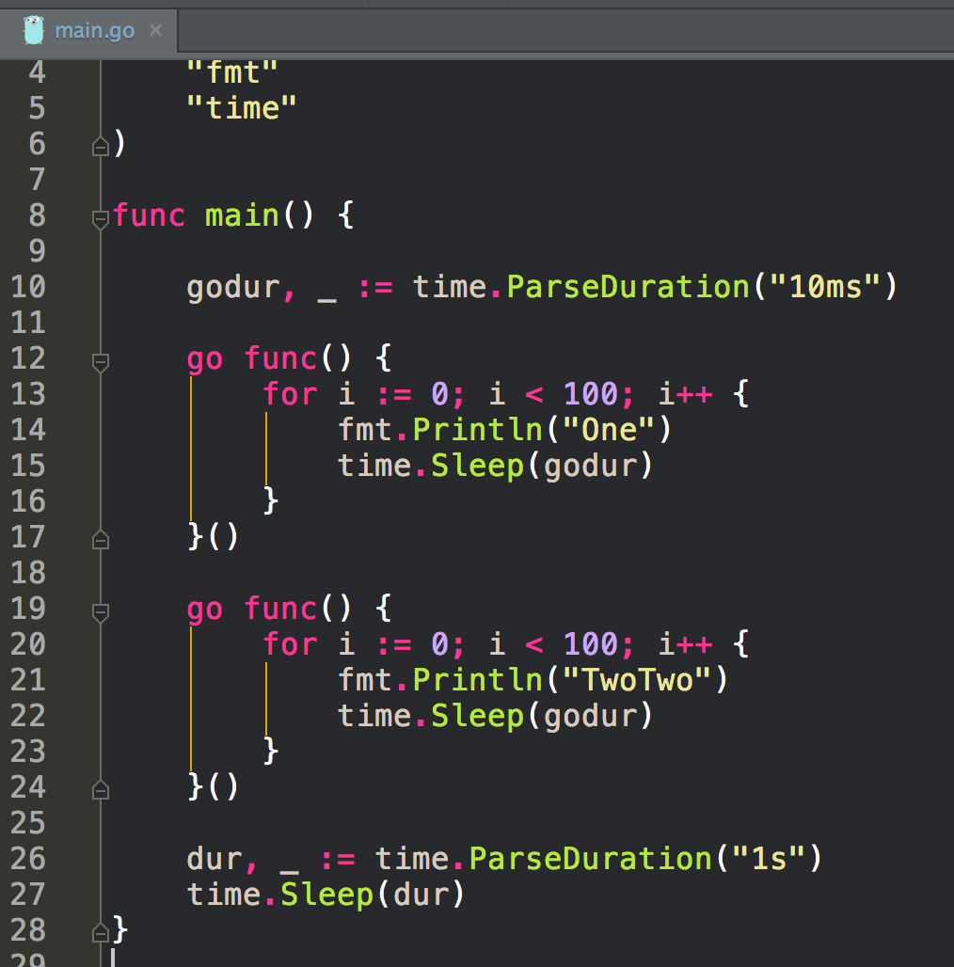
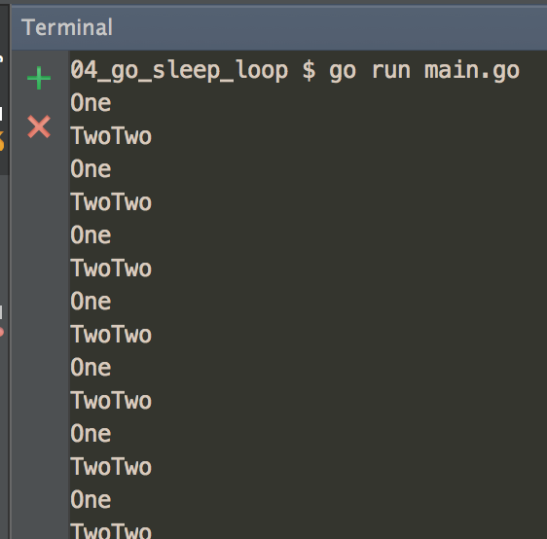

Slide 11
exercise
create a program that launches multiple threads

Slide 12
channels

Slide 13
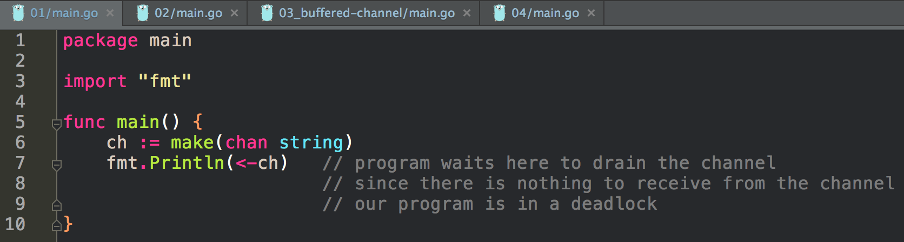
print-hello

Slide 14
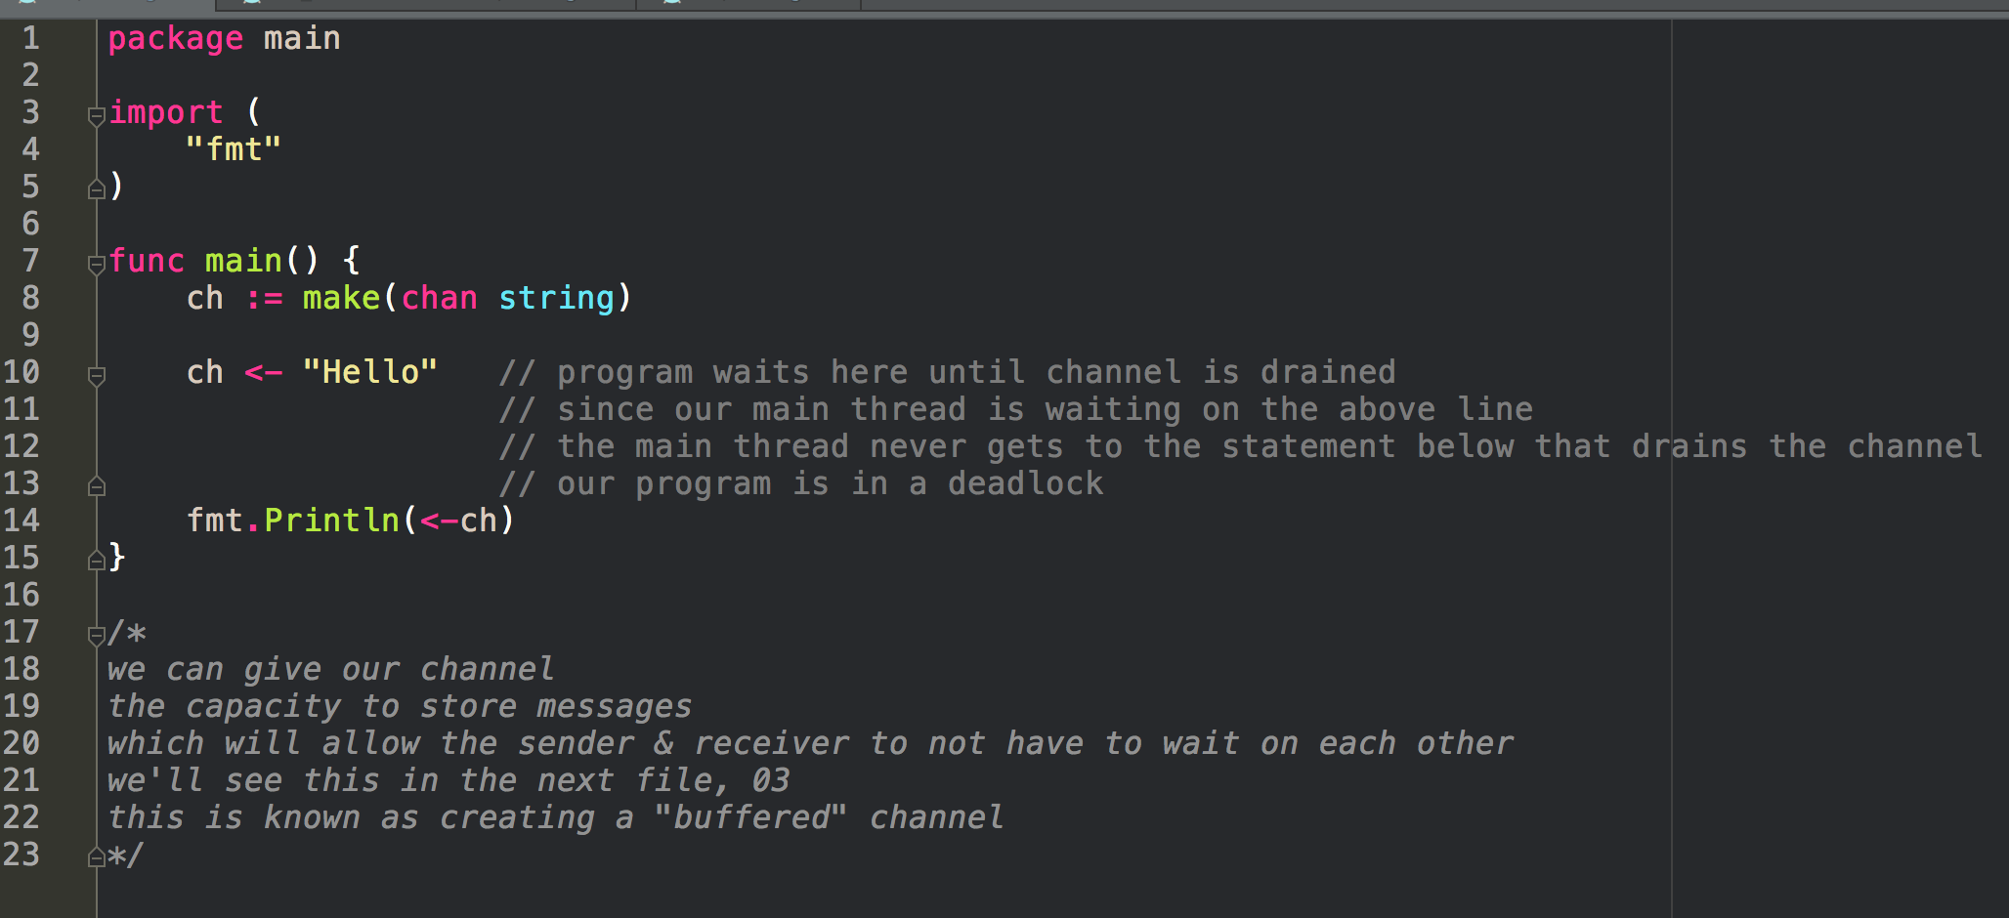
print-hello

Slide 15
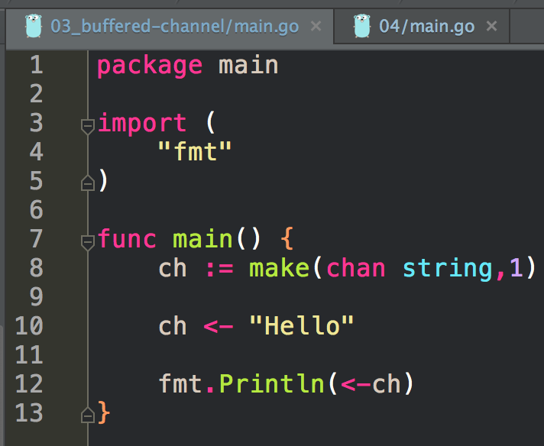
print-hello

Slide 16
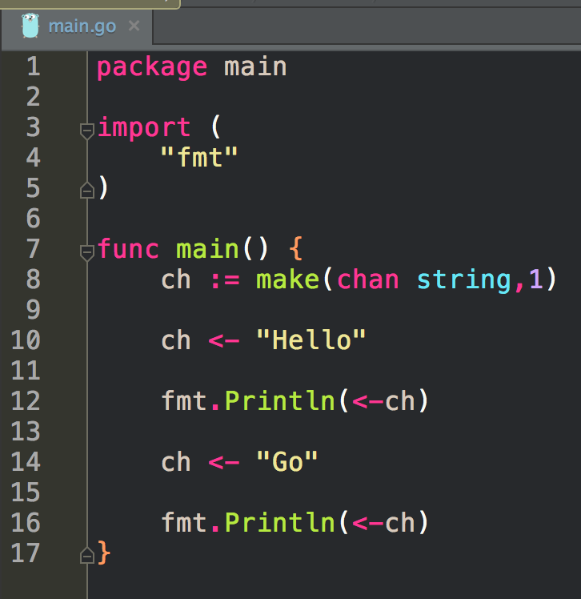
print-hello

Slide 17
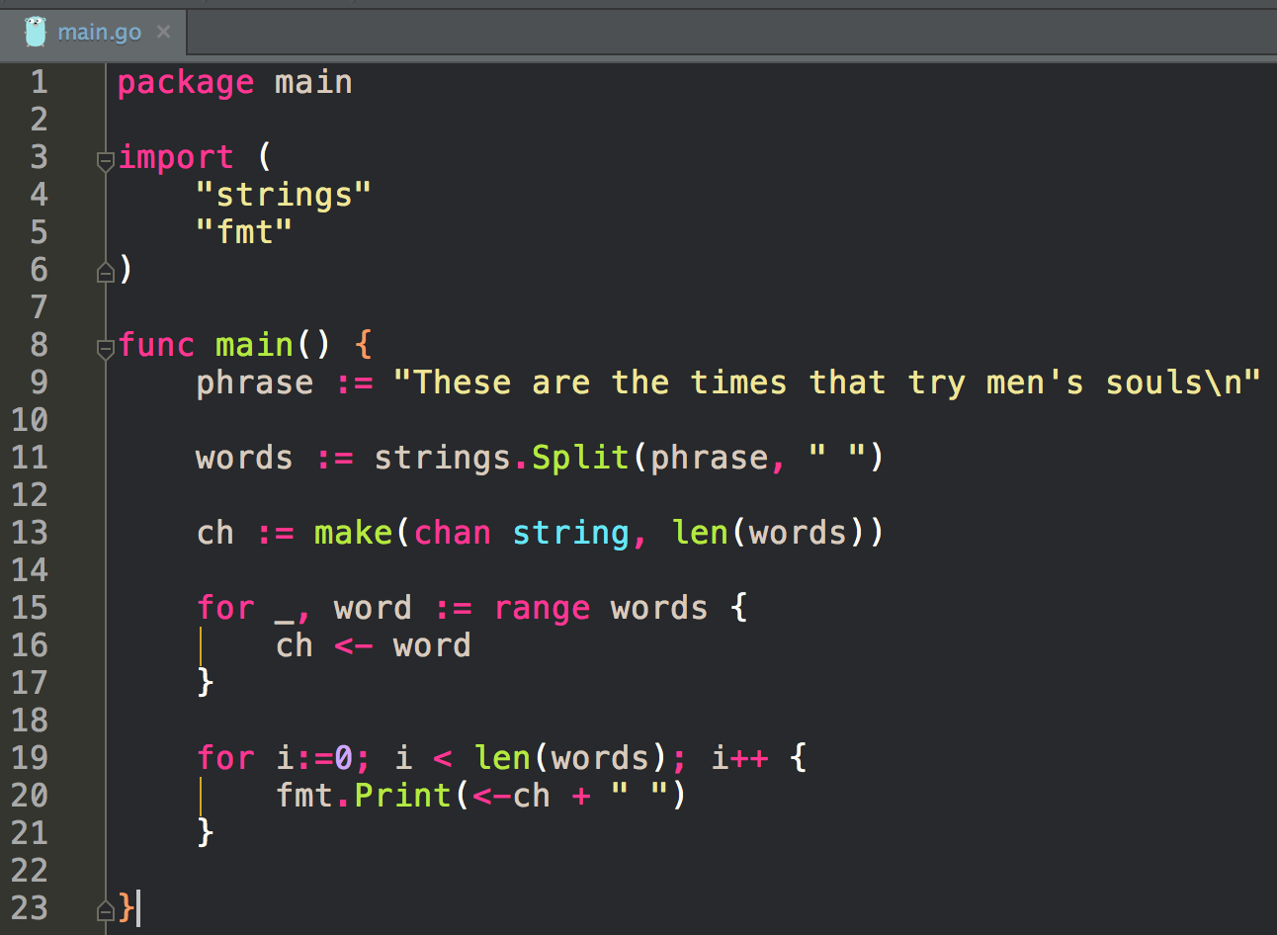
buffering

Slide 18
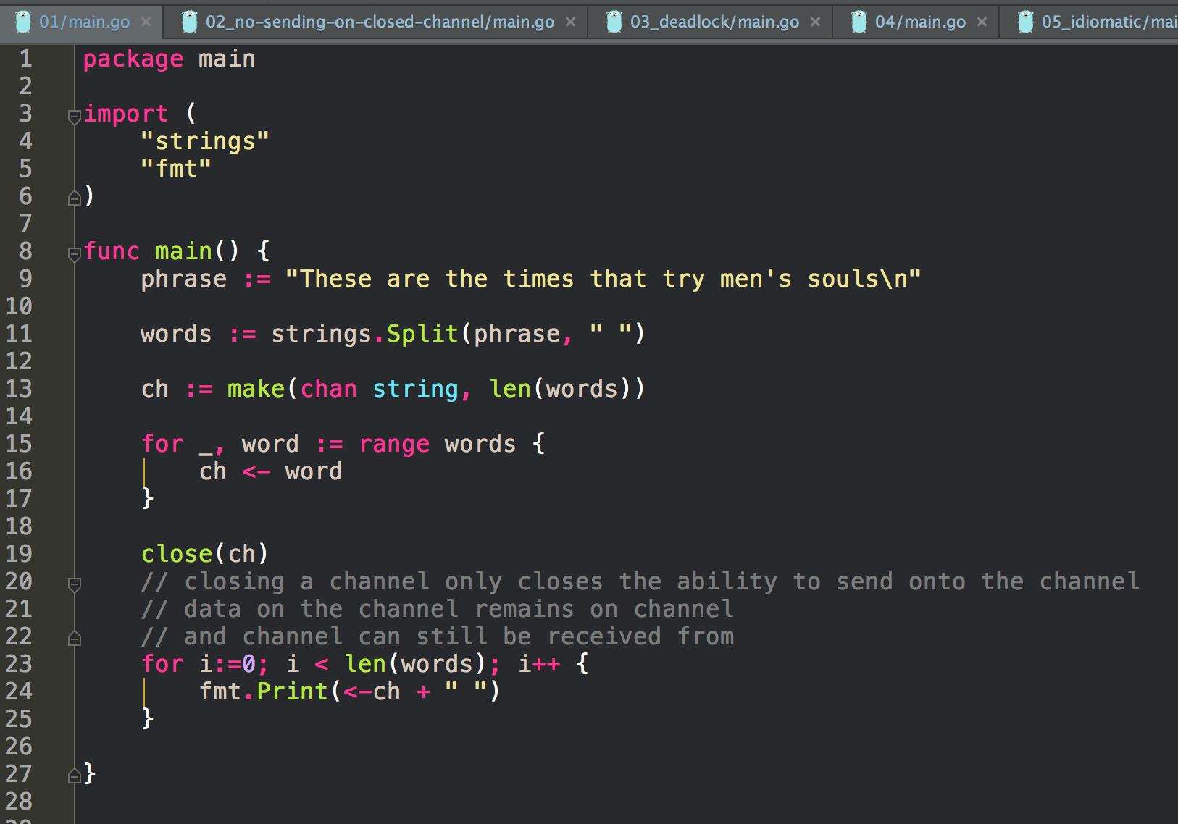
closing channel

Slide 19
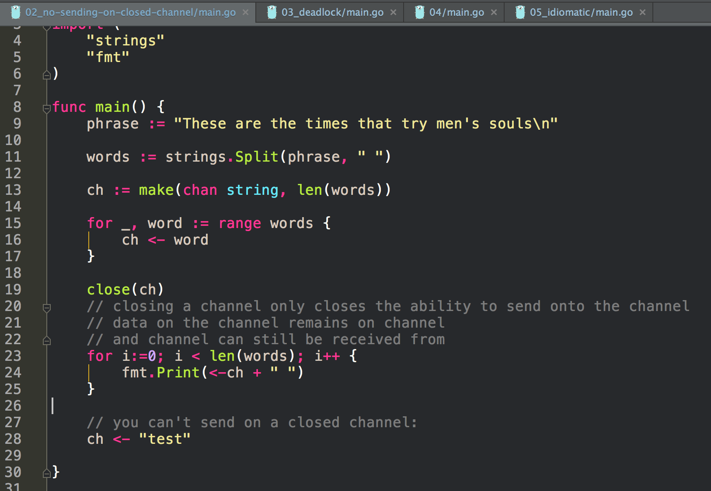
closing channel

Slide 20
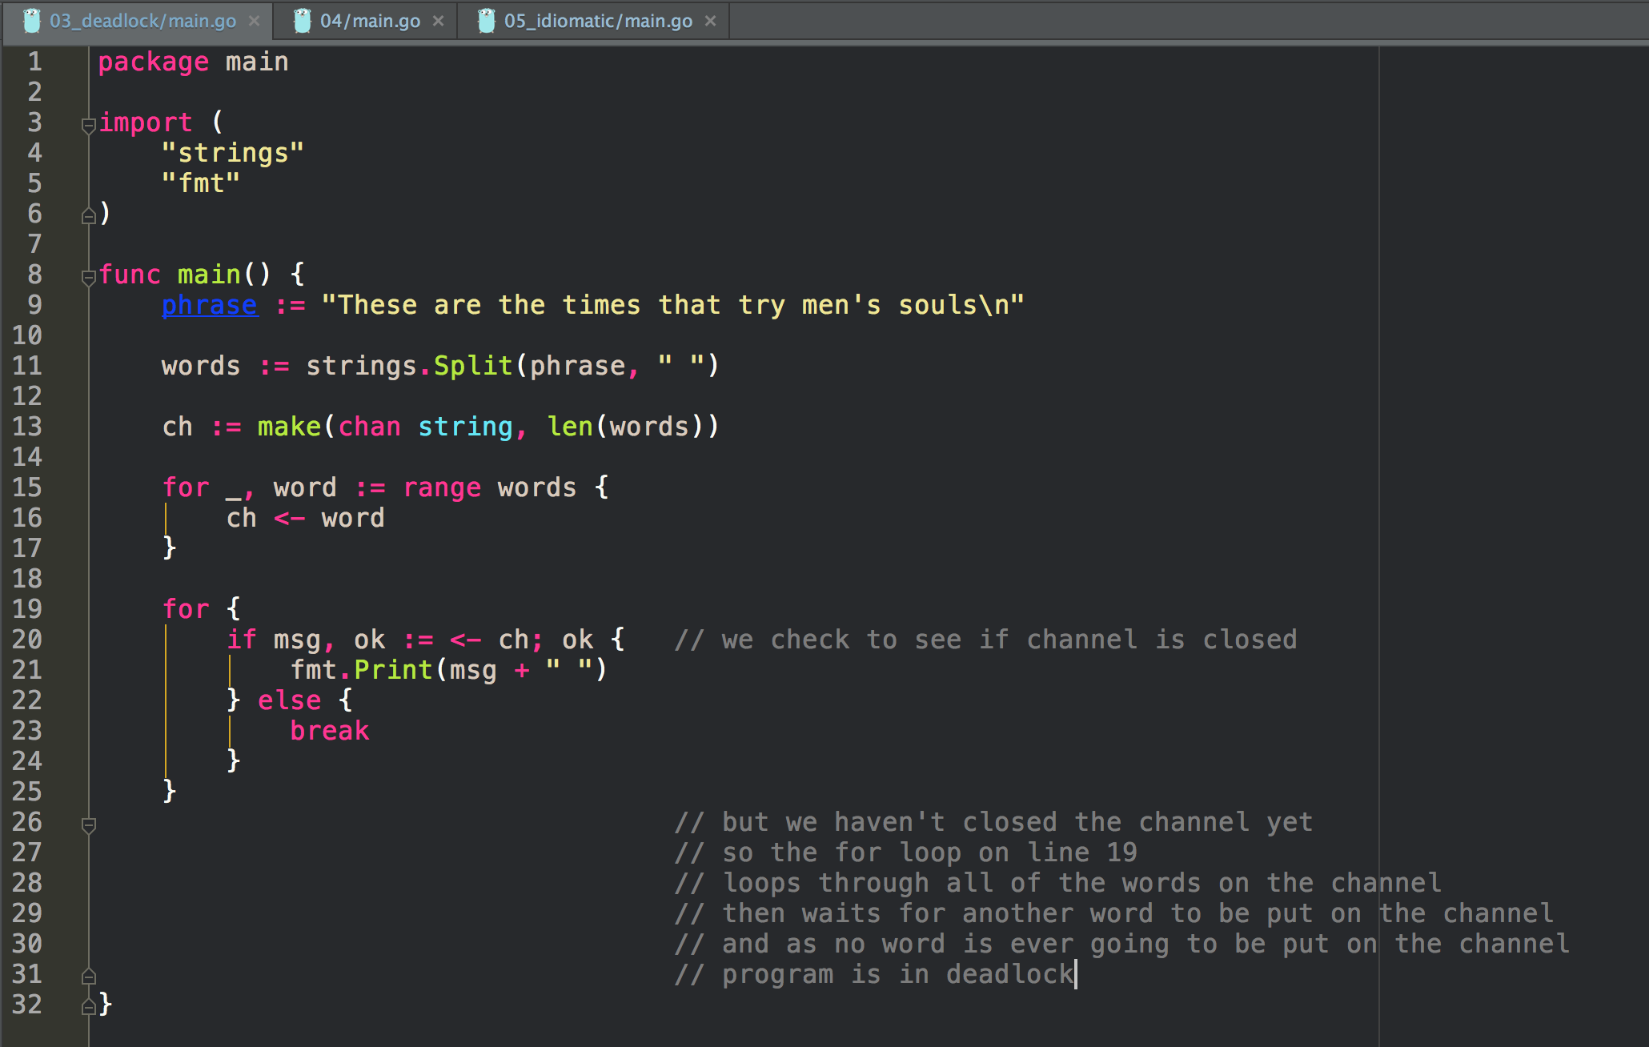
closing channel

Slide 21
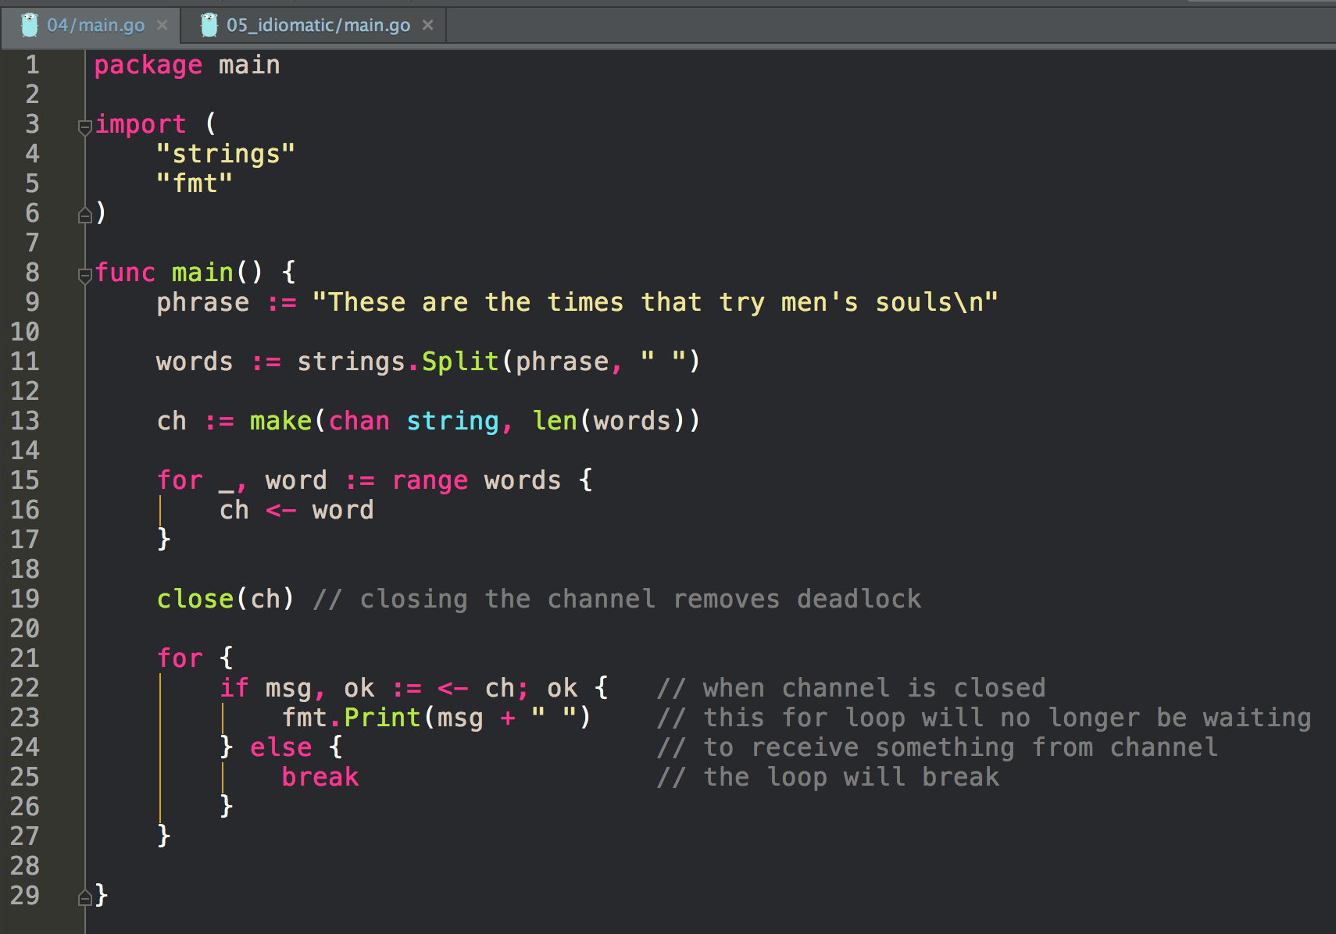
closing channel

Slide 22
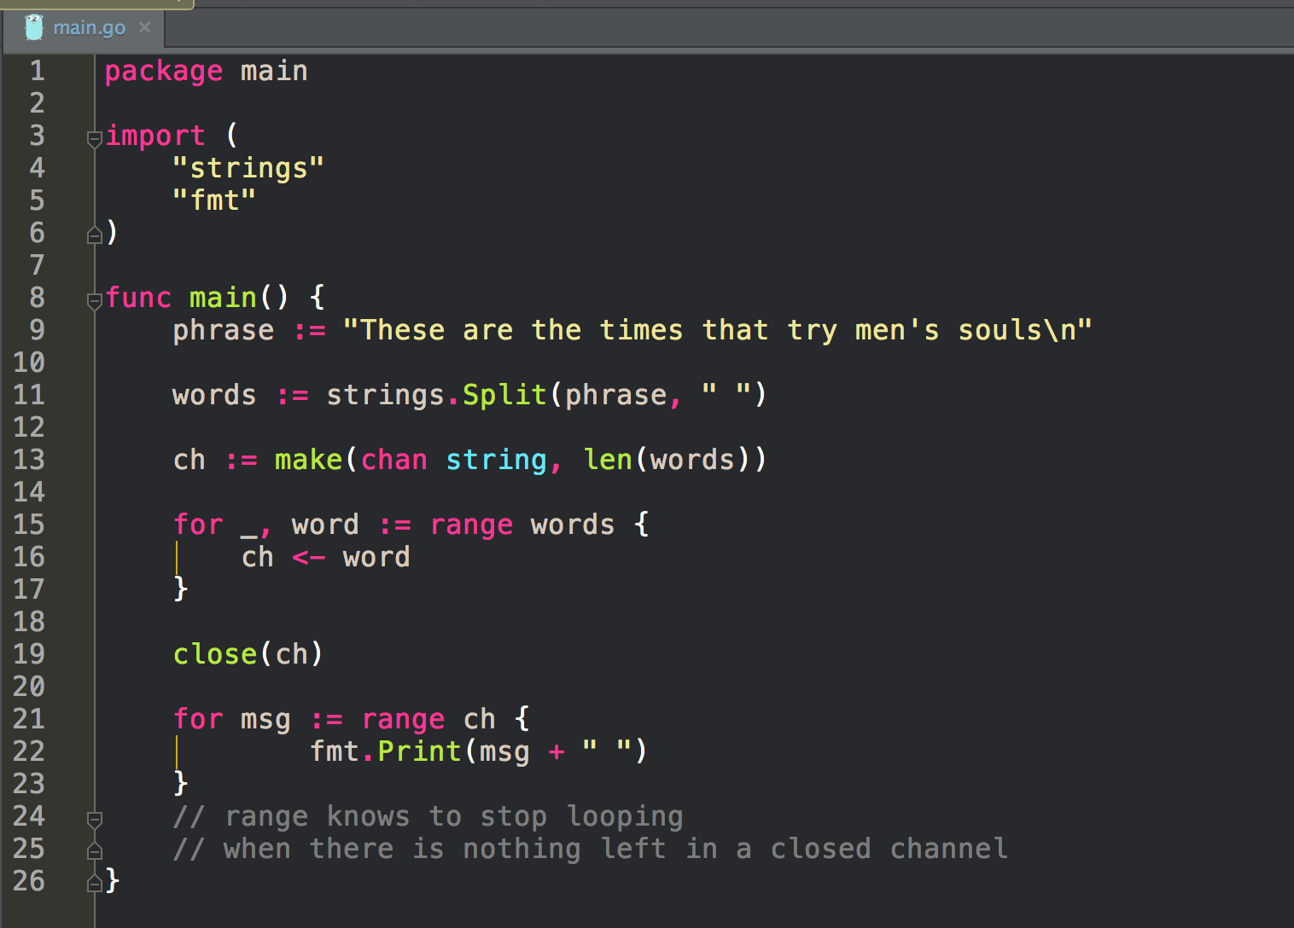
closing channel

Slide 23
exercise
create a program that demonstrates
putting a message onto a channel
and receiving that message from a channel
using a buffer

Slide 24
exercise
create a program that demonstrates a deadlock

Slide 25
exercise
create a program that uses a range loop
to loop over a closed channel
and display strings retrieved from the channel

Slide 26
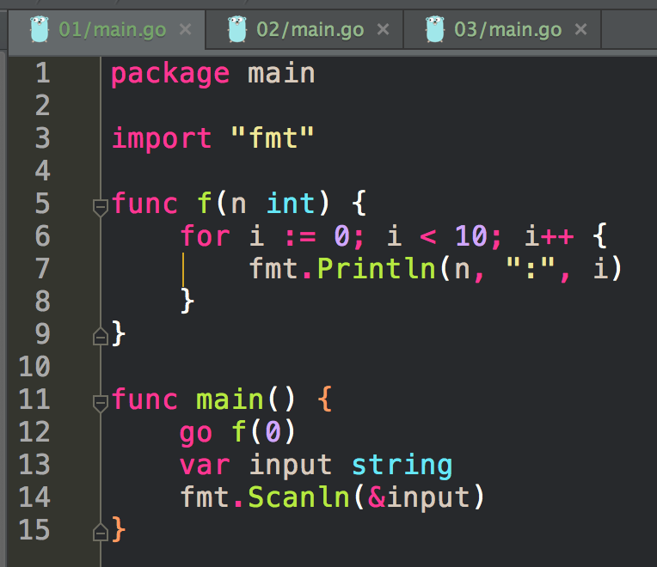
these files are all from
caleb’s book
http://www.golang-book.com/books/intro/10

Slide 27
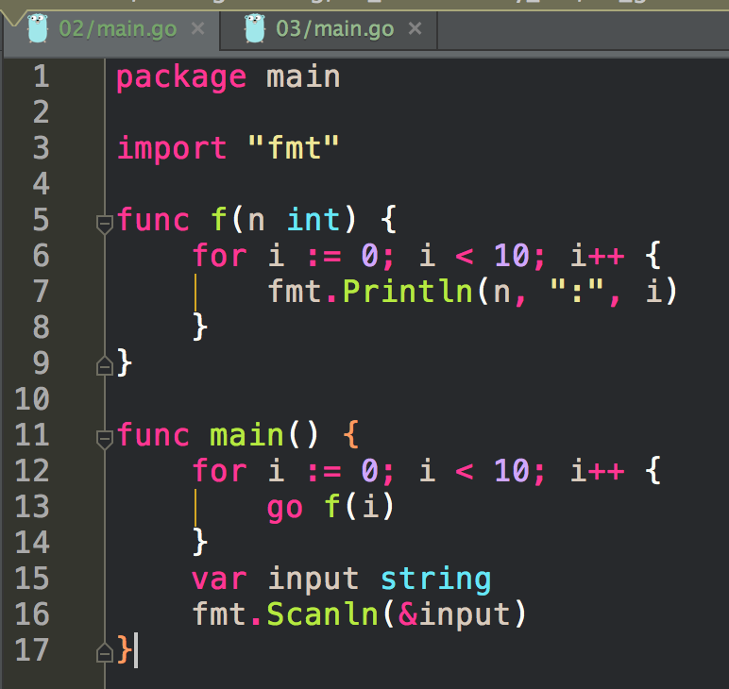

Slide 28
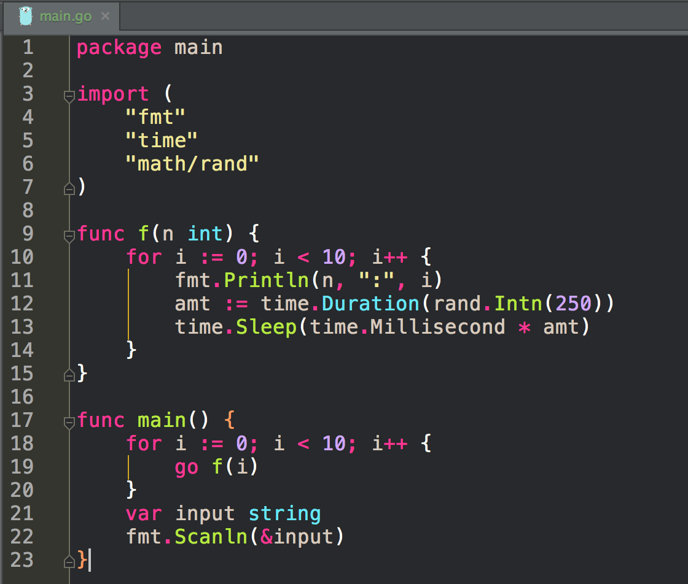
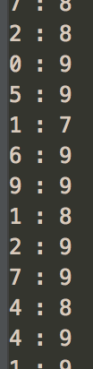

Slide 29
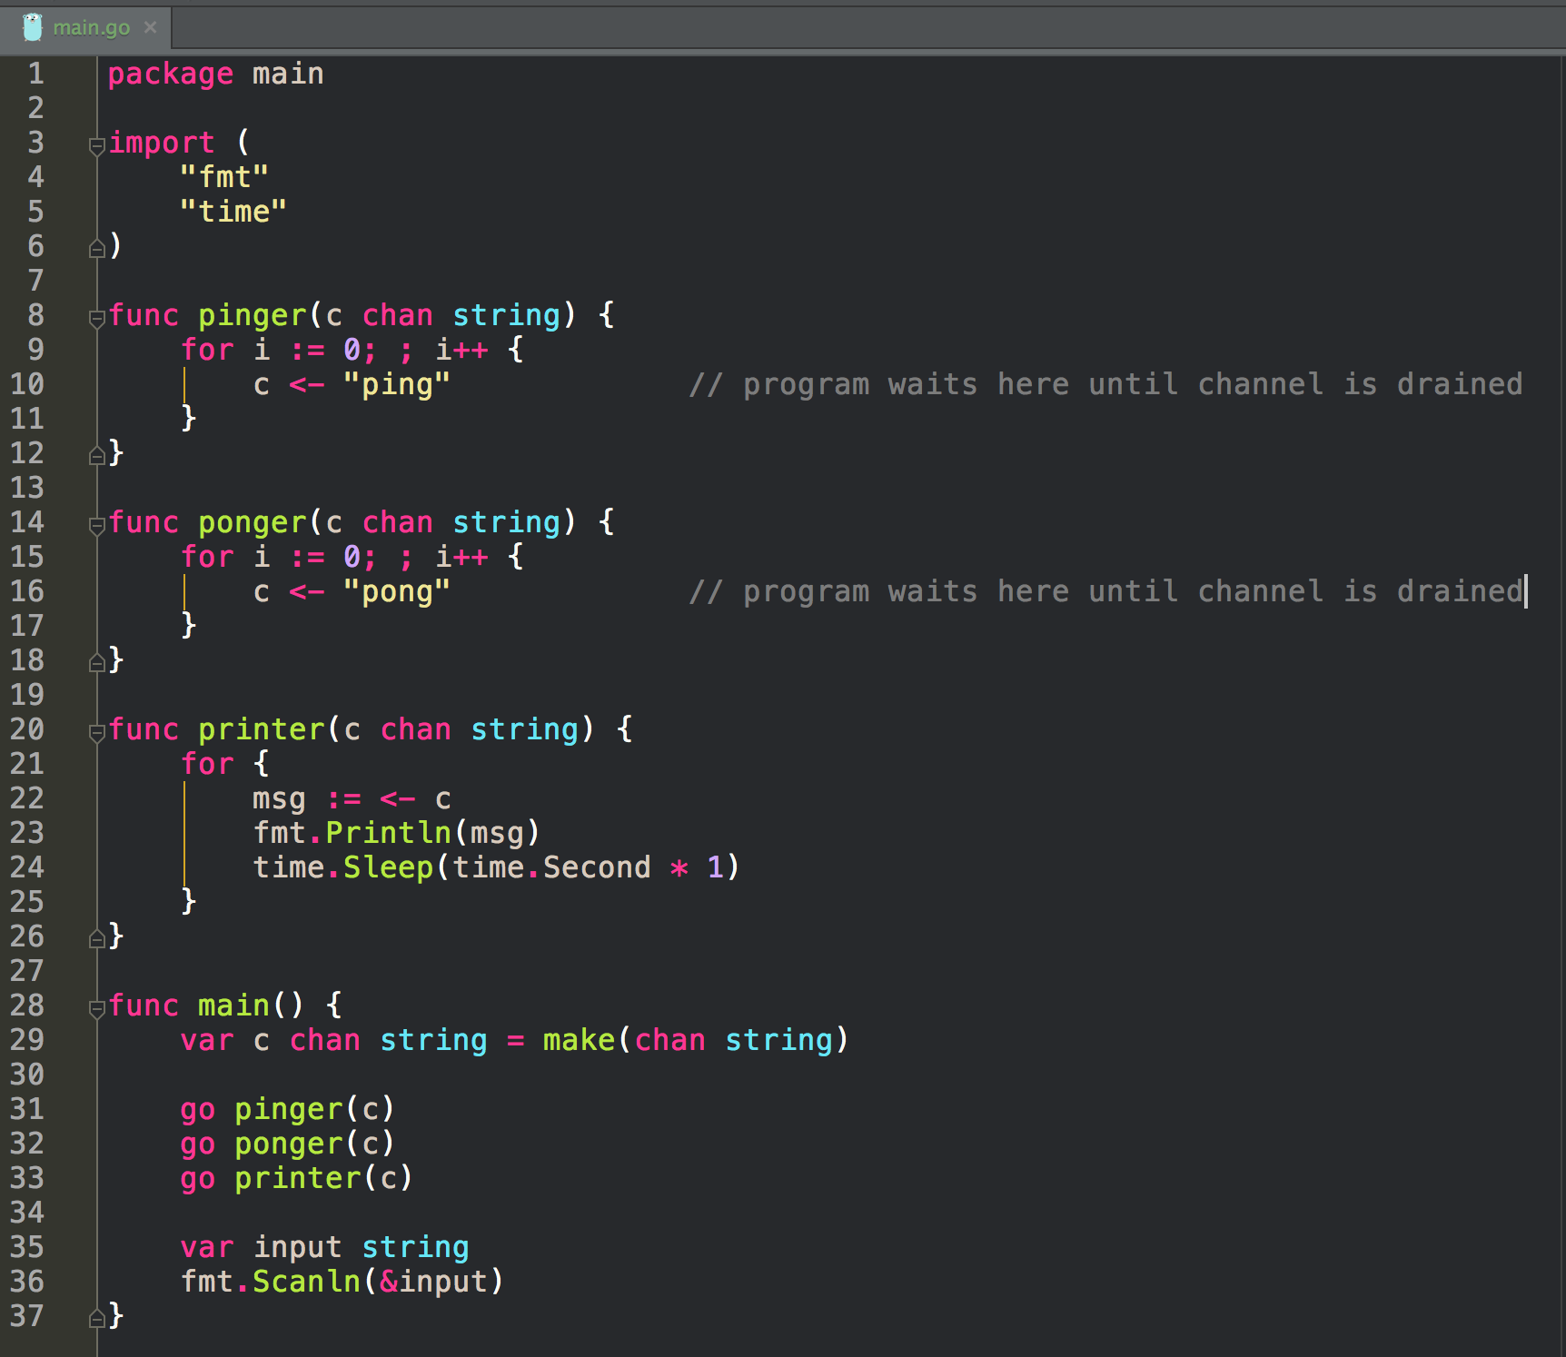

Slide 30
Review
Concurrency
doing many things
Parallelism
doing many things at the same time
go
launches thread
threads are virtual
chan
allows communication, orders events

